Slide 1
MaSIF
benchmark

Slide 2
Plan
1) Goal
2) The main challenge
3) Suggested solution
4) Per-protein results
A good case
A bad case
5) Overall results

Slide 3
Goal

Slide 4
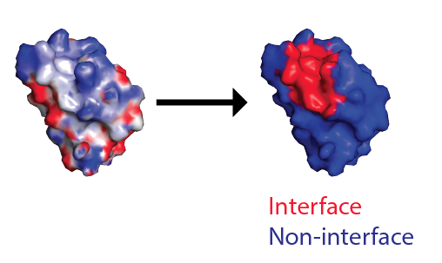
What we
want
have
static
dynamic
crystal
solvated
bound
unbound

Slide 5
The main challenge:
unbound

Slide 6
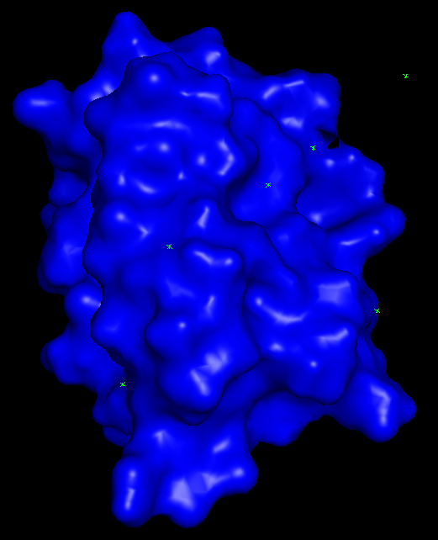
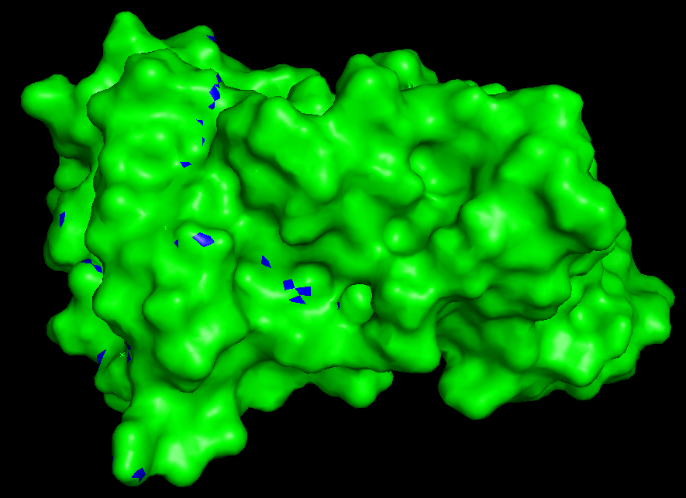
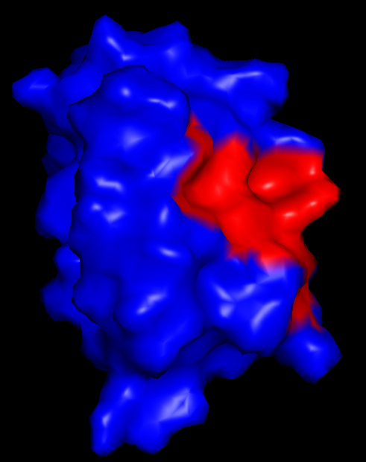
How they do it
No neib. inside r < D_{cut}
Bound chain
Bound complex

Slide 7
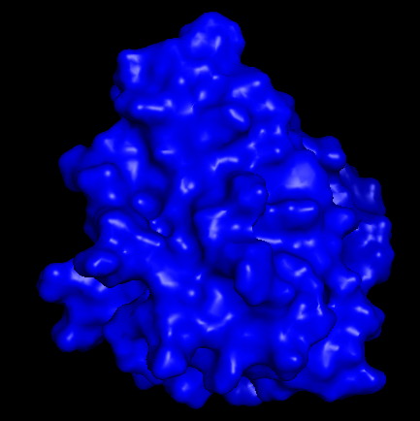


The problem
Unbound chain

Slide 8
Suggested solution

Slide 9
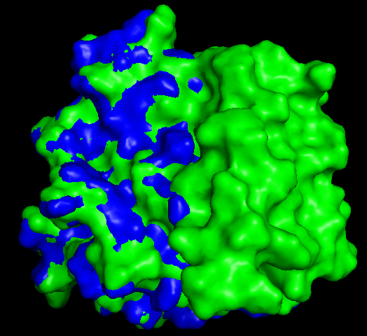
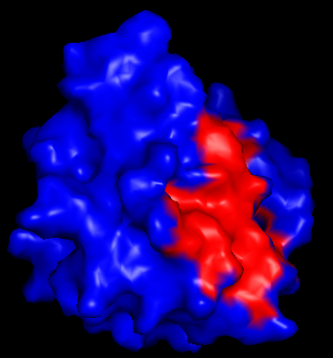
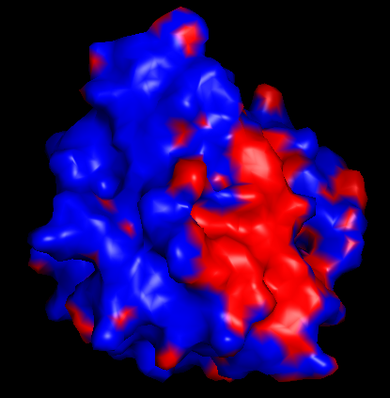
Solution
The problem
(not quite)
No neib. insize r < D_{cut}
Unbound chain MD
Complex MD, the best RMSD frame

Slide 10
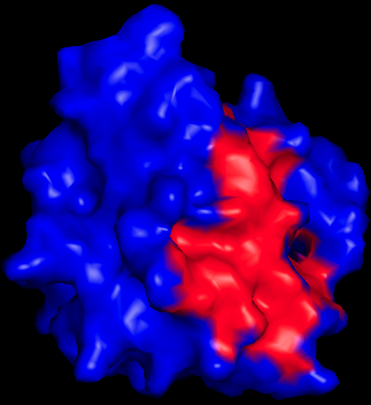
Filter noise
Filter criteria:
Keep only the biggest interface patch
True surface may contain of 2 or 3 big parts
Keep all patches with Nvertices > Ncut, Ncut ~ 50-150
Proteins differ in sizes, but this approach doesn’t account for that
Keep all patches with Nvertices > Nmax / a, a ~ 2-5
For small patches Nmax/a is approaching the size of noise patches
Keep all patches with Nvertices > max(Ncut, Nmax / a)
Theoretically should be more of less fine
Result: the 1st option was the only one which worked somewhat stable for all 20 proteins.
TODO:
Test other suggested criteria more thoroughly
Visually analyze all 20 cases, especially the strange ones, to get ideas for other criteria.

Slide 11
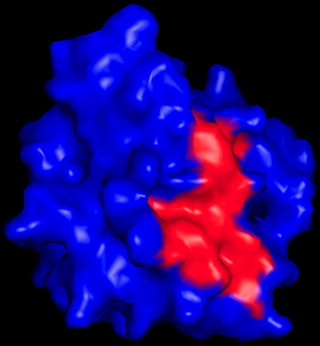
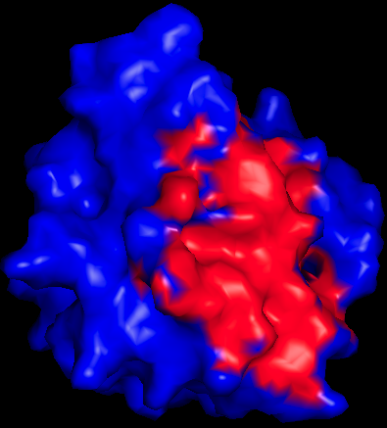
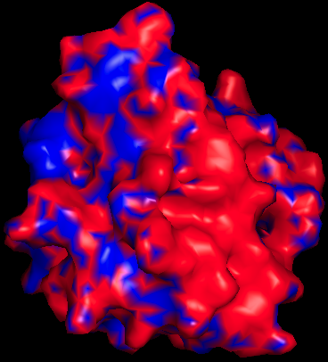
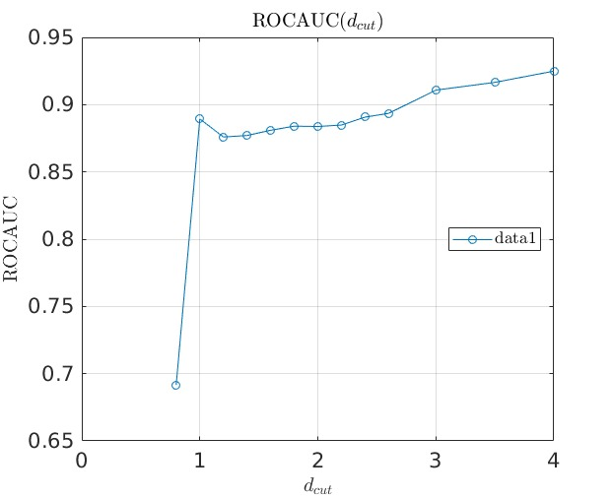
Choose D_{cut}
D_{cut} = 2.0 Å
D_{cut} = 5.0 Å
D_{cut} = 1.0 Å
D_{cut} = 0.5 Å
The smaller D_{cut} is the bigger noise patches are and the more connected their net is. Thus it’s harder to filter.
The bigger D_{cut} is the smaller the main patch is and thus it is less useful for the later steps like minimization.
MaSIF was trained with D_{cut} = 2.0 Å

Slide 12
Per-protein
results

Slide 13
1AK4-uR
a good case

Slide 14
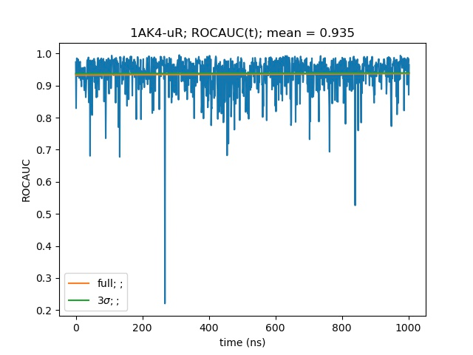
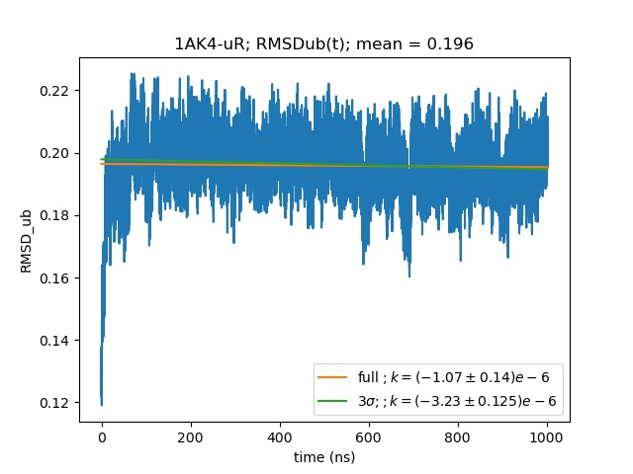
1AK4-uR - a good case
Great prediction rate
Structure is stable
1AK4-uR

Slide 15
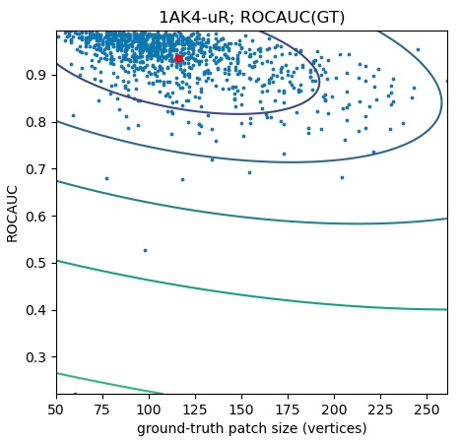
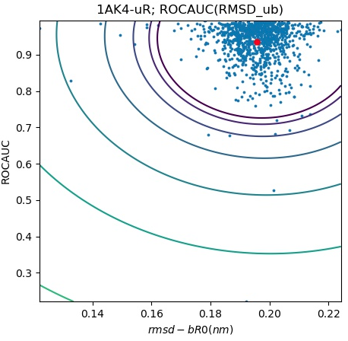
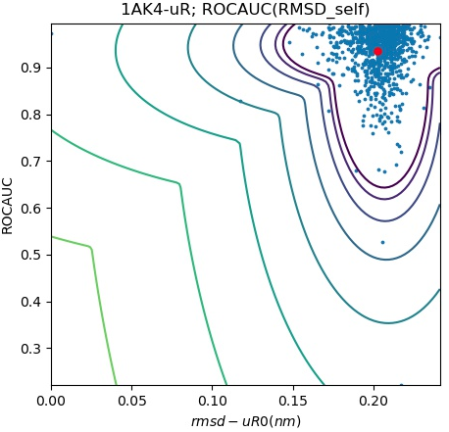
Correlation
(not found with anything)
1AK4-uR

Slide 16
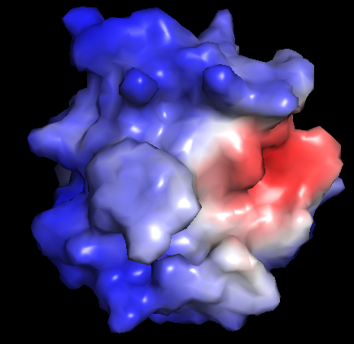
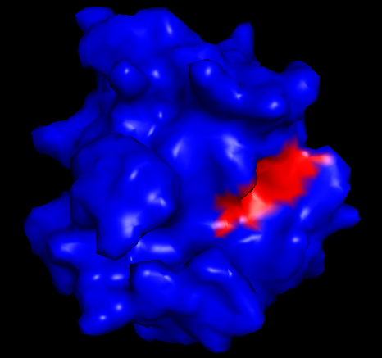
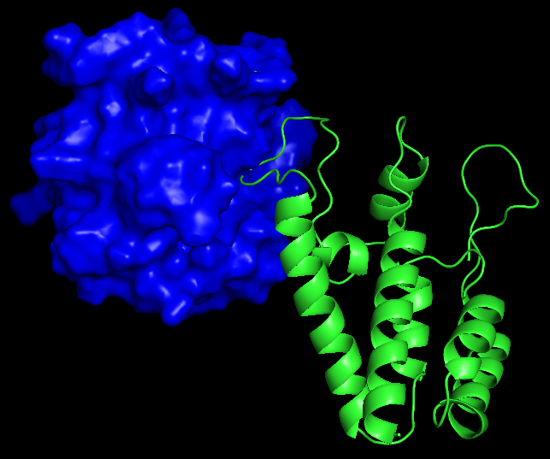
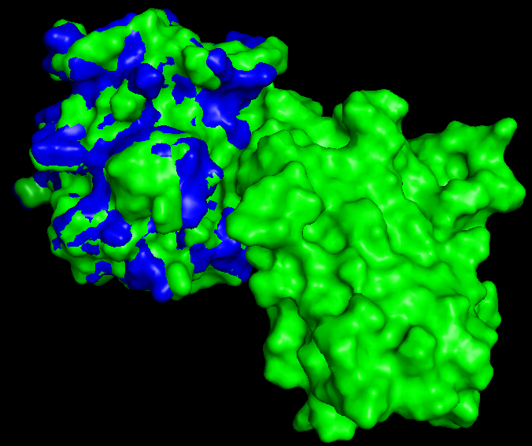
The best frame
ROCAUC ~ 0.995
Everything fits
1AK4-uR

Slide 17
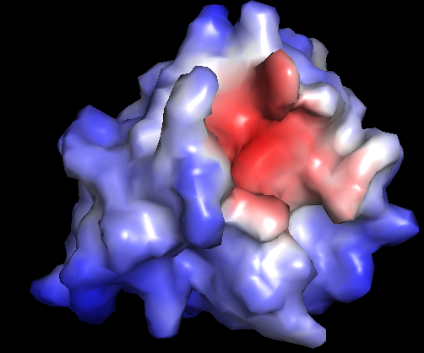
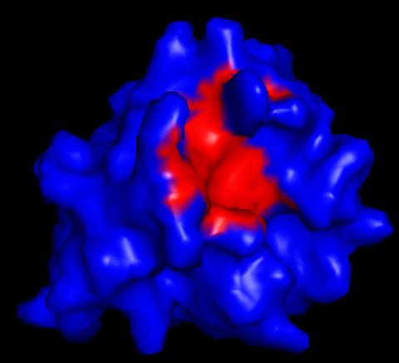
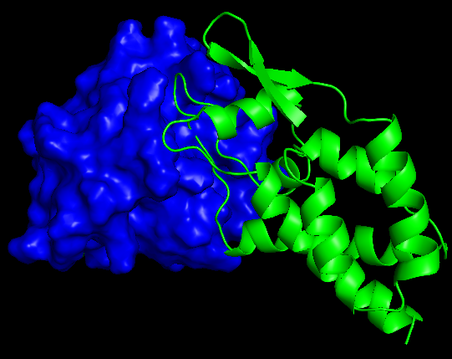
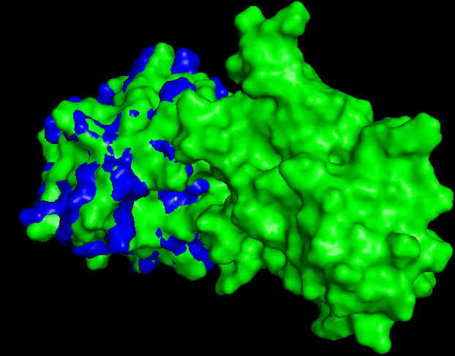
A typical frame
ROCAUC ~ 0.935
Everything fits
1AK4-uR

Slide 18
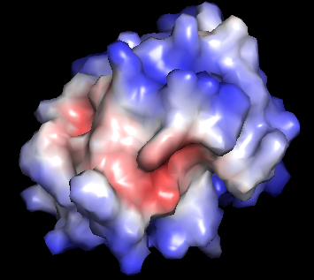
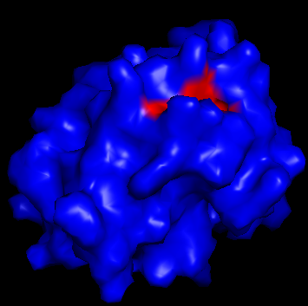
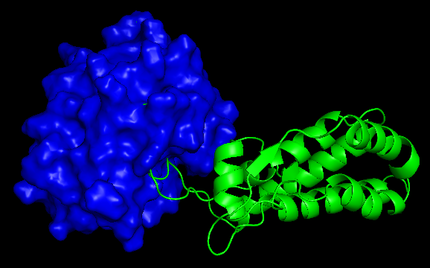
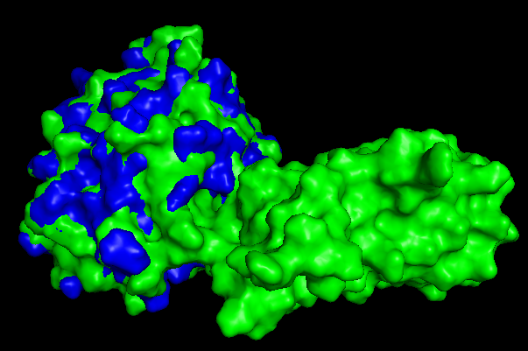
The worst frame
ROCAUC ~ 0.22
Occasional spikes -
GT fluctuations
TODO: design a better GT-identifier
Poss. sol: use bX and C, not C alone
1AK4-uR

Slide 19
2UUY-uR
a bad case

Slide 20
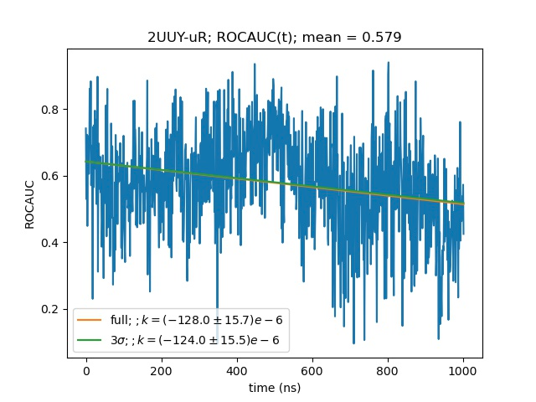
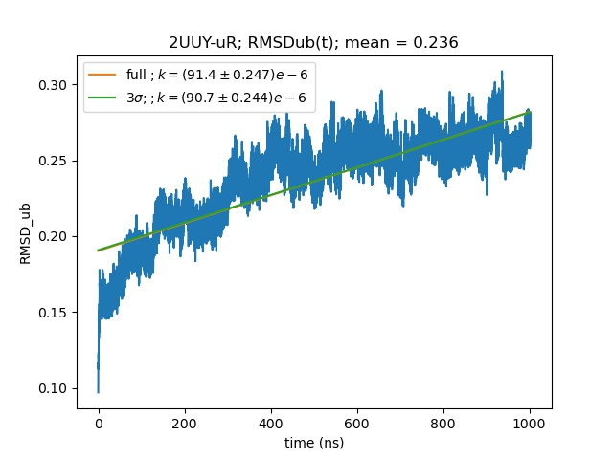
2UUY-uR - a bad case
Almost random classification
Structure is evolving
2UUY-uR

Slide 21
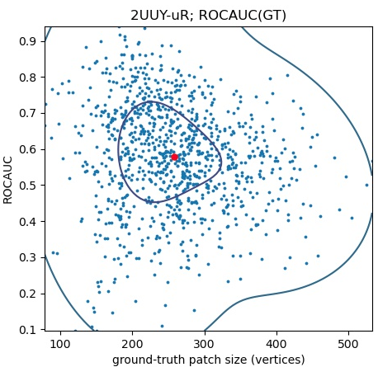
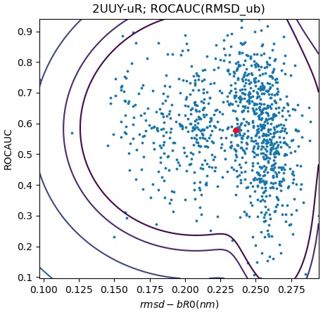
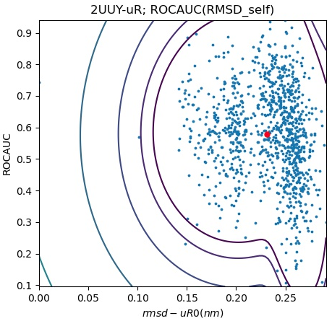
Correlations
Conformational change captured
TODO:
Time-coloring
Migration of the average
Account for the score < 1 condition in the classification
2UUY-uR

Slide 22
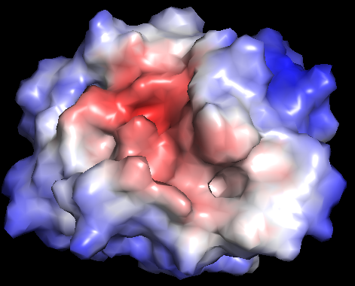
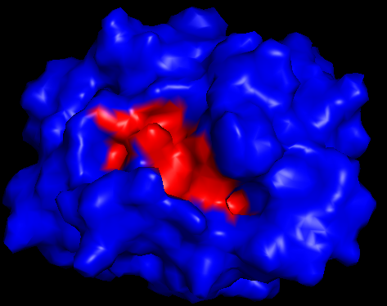
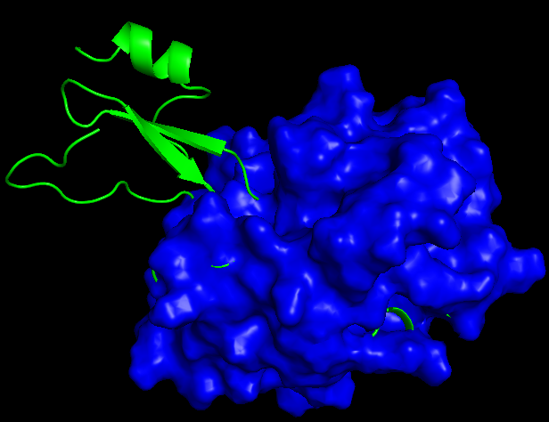
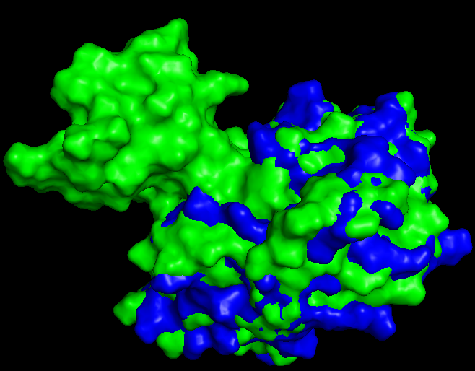
The best frame
ROCAUC ~ 0.94
Everything fits
2UUY-uR

Slide 23
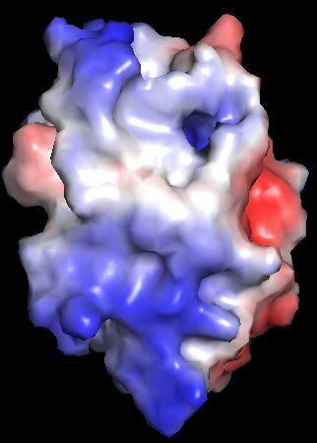
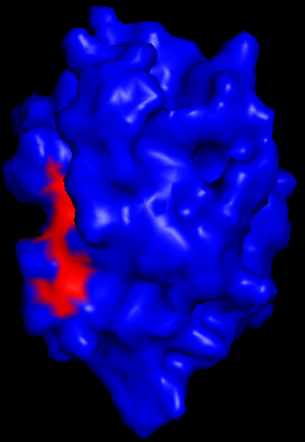
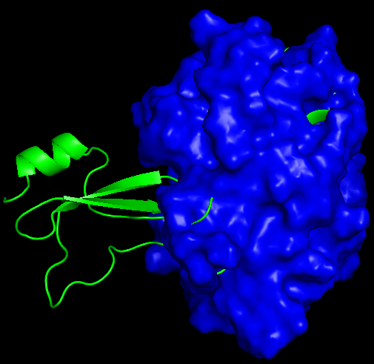
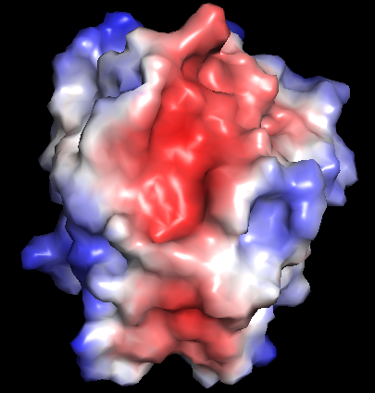
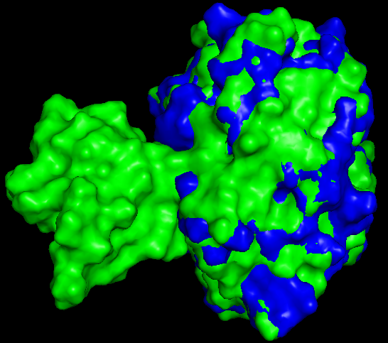
A typical frame
ROCAUC ~ 0.58
Systematic near random classification -
MaSIF error. It happens.
2UUY-uR

Slide 24
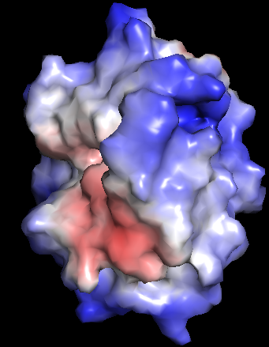
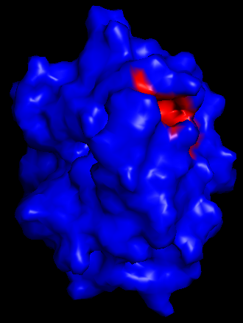
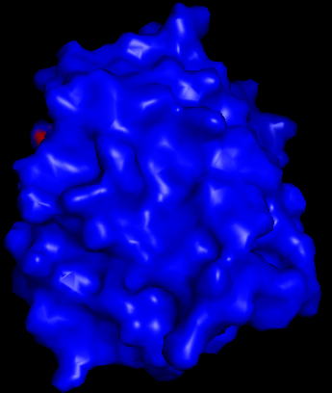
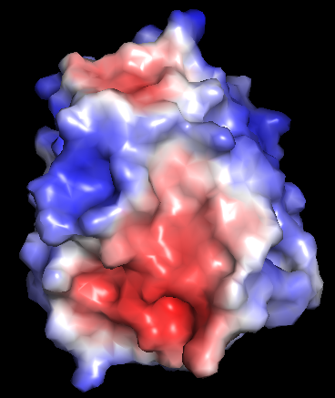
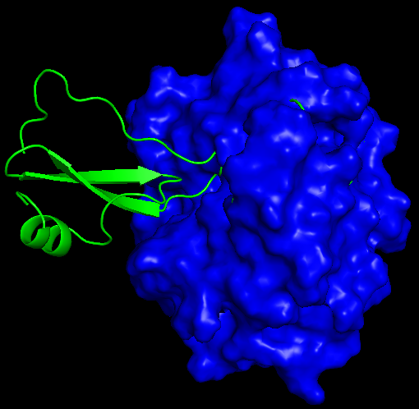
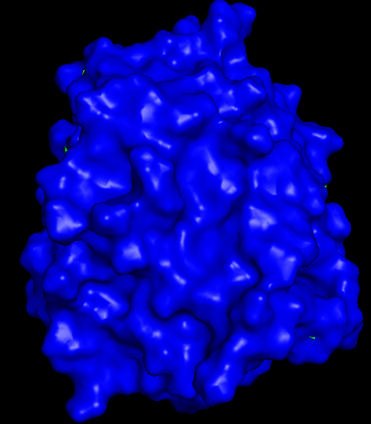

The worst frame
ROCAUC ~ 0.095
No predicted site on the auto-GT, low scores on the real GT
No real GT or auto-found GT on the predicted site
All combined -
just a bad luck
2UUY-uR

Slide 25
Overall results

Slide 26




Average ROCAUC

Slide 27




Correlations
TODO: find a measure of surface difference other than all-atom-RMSD
Possible solution:
MaSIF full fingerprint

Slide 28




More correlations
x40

Slide 29




score < 0.6 = x₁
R < 0: 71 % = y₁
R₁
R₂
R_{N}
score < 0.7 = x_{M}
R₁
R < 0: 63 % = y_{M}
R₂
R_{N}

Slide 30
Conclusions
1) Suggested GT for unbound structures
2) Found and analyzed different cases
3) Benchmarked all provided PDBs
4) found moderate correlations

Slide 31
TODO
Test other suggested GT criteria more thoroughly.
Visually analyze all 20 cases, especially the strange ones, to get ideas for other GT criteria.
Possibly use bX MD-s alongside with the C MD-s.
Think of a better interface-sensitive or at least surface-sensitive distance measure.
Possibly use full MaSIF fingerprints
Verify ability to capture conformations on the RMSD-ROCAUC or other Dist-ROCAUC scatters.
Accounts for score < 1 condition in the classification
Study time evolution of average values on the Dist-ROCAUC scatters.
Get a cluster to run more detailed analysis using already written pipeline.
Contact somebody who have already done the installation of MaSIF on a cluster
Having a good GT identifier and a good surface-distance measure, we can use all 20 trajectories to complement MaSIF training since every trajectory contain quite varied conformations.

Slide 32


Impact of being in the train set
Not found

Slide 33
1AK4-uL
a bad case

Slide 34


1AK4-uL - a bad case
Worse than random classification
Evolving structure
1AK4-uL

Slide 35



Correlation
(not found with anything)
1AK4-uL

Slide 36




The best frame
ROCAUC ~ 0.97
Occasional match of my GT with MaSIF scores
1AK4-uL

Slide 37






A typical frame
ROCAUC ~ 0.46
1AK4-uL

Slide 38






The worst frame
R.A.
~ 0.035
1AK4-uL

